Slide 1
Graphics
ggplot2

Slide 2
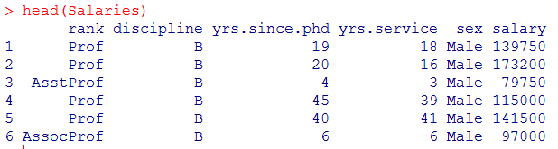
Datasets
data(Salaries, package="car")
Salaries from the car package (2008-2009 9 month academic salaries n=397)
rank (AssocProf, AsstProf, Prof)
salary in dollars
discipline (A=theoretical, B=applied)
sex (Female, Male)
yrs.since.phd.
yrs.service

Slide 3
Grammar of Graphics
data: an R data frame
coordinate system: 2-D space data projected onto (e.g. Cartesian coordinates, polar coordinates, map projections)
geoms: type of geometric objects that represent data (e.g. points, lines, bars)
aesthetics: visual characteristics that represent data (e.g. position, size, color, shape, transparency, fill)
scales: for each aesthetic, how visual characteristic is converted to display values
stats: statistical transformations that summarize data (e.g., counts, means, trend lines)
facets: how data is split into subsets and displayed as small multiples
Thanks to Dawn Koffman ggplot2 presentation

Slide 4
Simple bar plot
ggplot(data=Salaries, aes(x=rank)) + geom_bar()
common geom_bar options:
width
fill
color (border)
position

Slide 5
Stacked bar plot
ggplot(data=Salaries, aes(x=rank, fill=sex)) + geom_bar()

Slide 6
Grouped bar plot
ggplot(data=Salaries, aes(x=rank, fill=sex)) + geom_bar( position="dodge")

Slide 7
Spinogram
ggplot(data=Salaries, aes(x=rank, fill=sex)) + geom_bar( position="fill")

Slide 8
Histogram
ggplot(data=Salaries, aes(x=salary)) + geom_histogram()
common geom_histogram options:
binwidth
bins
color (border)
fill

Slide 9
Frequency polygons
ggplot(data=Salaries, aes(x=salary)) + geom_freqpoly()
common geom_freqpoly options:
binwidth
bins
color
size (thickness of line)

Slide 10
Frequency polygons
ggplot(data=Salaries, aes(x=salary, color=rank)) + geom_freqpoly(size=2)
common geom_freqpoly options:
binwidth
bins
color
size (thickness of line)

Slide 11
Kernel density plot
ggplot(data=Salaries, aes(x=salary)) + geom_density(fill="red")
common geom_density options:
fill
color
alpha

Slide 12
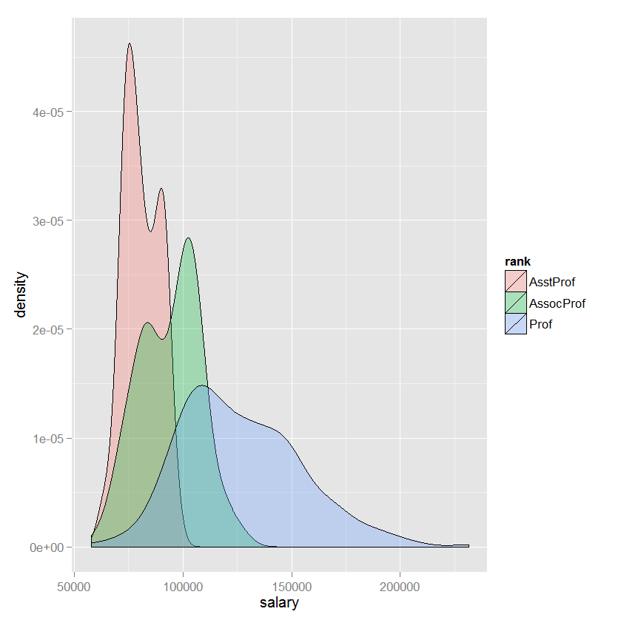
Kernel density plot - multiple groups
ggplot(data=Salaries, aes(x=salary, fill=rank)) + geom_density(alpha=.3)

Slide 13
Box plot
ggplot(data=Salaries, aes(x=rank, y=salary)) + geom_boxplot()
common geom_boxplot options:
fill
color
notch (=TRUE or FALSE)
outlier. -color shape size

Slide 14
Strip plot
ggplot(data=Salaries, aes(x=salary, y=rank)) + geom_point()
common geom_point options:
color
alpha
shape
size

Slide 15
Jittered Strip plot
ggplot(data=Salaries, aes(x=salary, y=rank)) + geom_jitter()
common geom_jitter options:
color
alpha
shape
size

Slide 16
Scatter plot
ggplot(data=Salaries, aes(x=yrs.since.phd, y=salary)) + geom_point()
common geom_point options:
color
alpha
shape
size

Slide 17
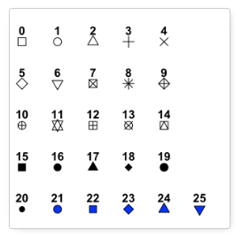
Changing point shapes
+ geom_point(shape = 15)
for 21-25 you
can control both
the fill and the border

Slide 18
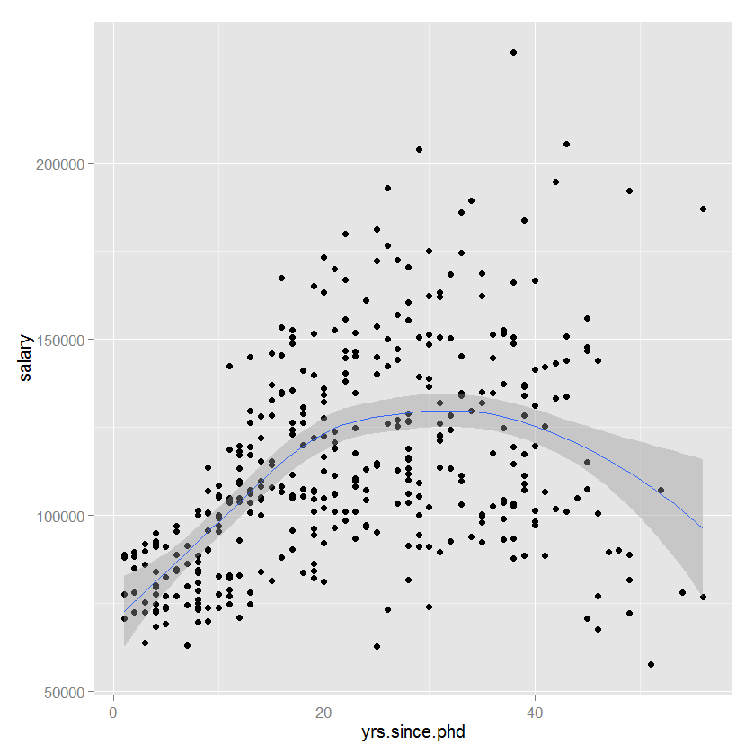
Scatterplot with fit
ggplot(data=Salaries, aes(x=yrs.since.phd, y=salary)) + geom_point() + geom_smooth()
common geom_smooth options
method ("lm", "loess", "gam")
se (TRUE or FALSE) formula

Slide 19
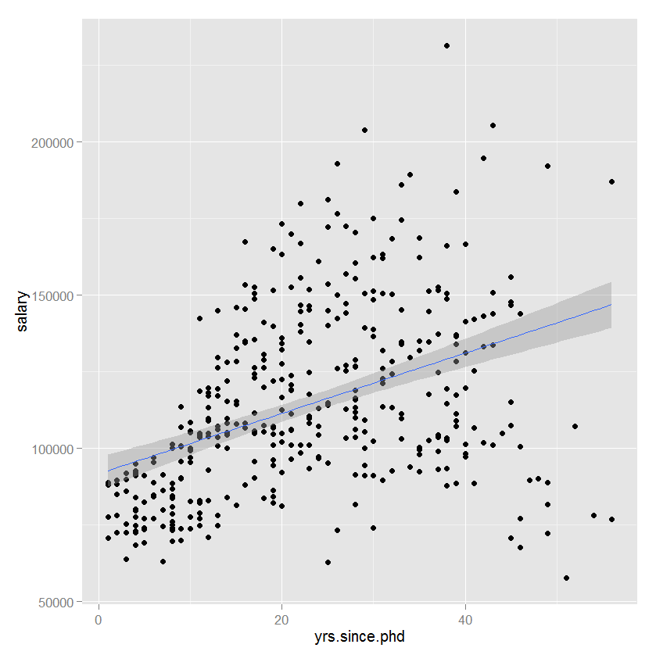
Scatterplot with fit
ggplot(data=Salaries, aes(x=yrs.since.phd, y=salary)) + geom_point() + geom_smooth(method="lm", formula=y~x)
try formula = y~poly(x, 2)

Slide 20
Grouping
Add
color,
shape,
size,
alpha
to
aes
or the
geom_xxx()
careful of
aesthetics vs attributes

Slide 21
Grouping
ggplot(data=Salaries, aes(x=yrs.since.phd, y=salary, color=rank)) + geom_point()

Slide 22
Grouping
ggplot(data=Salaries, aes(x=yrs.since.phd, y=salary, color=rank, shape=sex)) + geom_point()

Slide 23
Grouping
ggplot(data=Salaries, aes(x=yrs.since.phd, y=salary, color=rank, shape=rank)) + geom_point()

Slide 24
Facets
facets_grid( rowvar ~ colvar)
facets_grid( . ~ colvar) just columns
facets_grid(rowvar ~ .) just rows
facets_wrap(~ var, ncol=#) one classification variable wrapped to fill page

Slide 25
Facets
ggplot(data=Salaries, aes(x=yrs.since.phd, y=salary)) + geom_point() + facet_grid(. ~ sex)

Slide 26
Facets
ggplot(data=Salaries, aes(x=yrs.since.phd, y=salary)) + geom_point() + facet_grid(sex ~ rank)

Slide 27
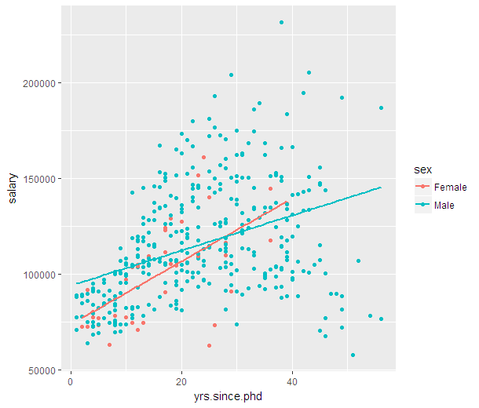
Aesthetics in ggplot( ) vs geom_xxx( )
library(ggplot2)
data(Salaries, package="car")
ggplot(data=Salaries, aes(x=yrs.since.phd, y=salary, color=sex )) +
geom_point() +
geom_smooth(method="lm", se=FALSE)

Slide 28
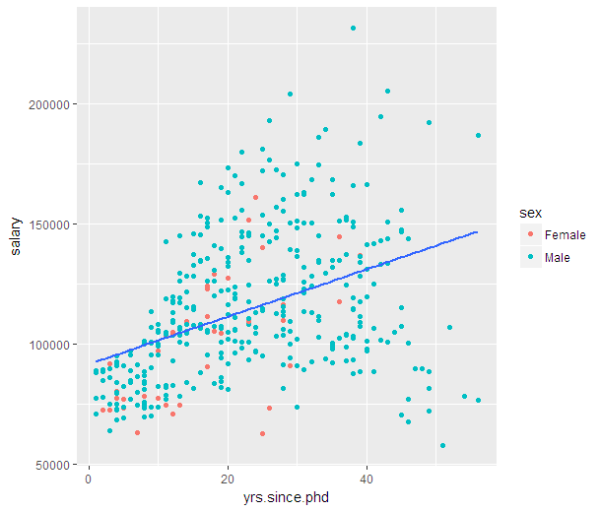
Aesthetics in ggplot( ) vs geom_xxx( )
ggplot(data=Salaries, aes(x=yrs.since.phd, y=salary )) +
geom_point(aes(color=sex)) +
geom_smooth(method="lm", se=FALSE)

Slide 29
Geoms
geom_abline | Reference lines: horizontal, vertical, and diagonal
geom_bar | Bars charts
geom_bin2d | Heatmap of 2d bin counts
geom_blank | Draw nothing
geom_boxplot | A box and whiskers plot (in the style of Tukey)
geom_contour | 2d contours of a 3d surface
geom_count | Count overlapping points
geom_density | Smoothed density estimates
geom_density_2d | Contours of a 2d density estimate
geom_dotplot | Dot plot
geom_errorbarh | Horizontal error bars
geom_hex | Hexagonal heatmap of 2d bin counts
geom_freqpoly | Histograms and frequency polygons
geom_jitter | Jittered points
geom_crossbar | Vertical intervals: lines, crossbars & errorbars
geom_map | Polygons from a reference map
geom_path | Connect observations
geom_point | Points
geom_polygon | Polygons
geom_qq | A quantile-quantile plot
geom_quantile | Quantile regression
geom_ribbon | Ribbons and area plots
geom_rug | Rug plots in the margins
geom_segment | Line segments and curves
geom_smooth | Smoothed conditional means
geom_spoke | Line segments parameterised by location, direction and distance
geom_label | Text
geom_raster | Rectangles
geom_violin | Violin plot

Slide 30
Line charts
ggplot(economics, aes(date, unemploy)) + geom_line()

Slide 31
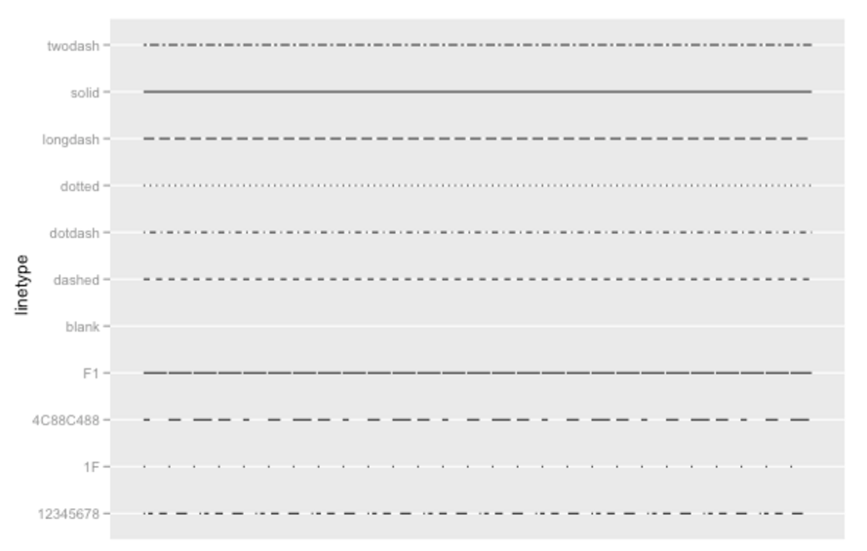
Line charts
Changing the linetype

Slide 32
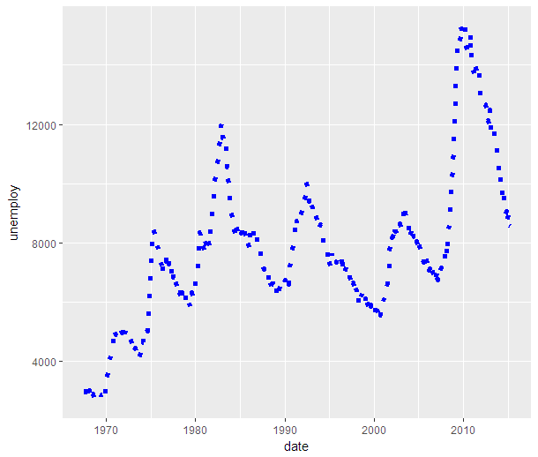
Line charts
ggplot(economics, aes(date, unemploy)) + geom_line(linetype="dotted", color="blue", size=1)

Slide 33
Scales
scale_x_continuous()
scale_y_continuous()
scale_x_discrete()
scale_y_discrete()
scale_color_continuous()
scale_color_manual() scale_color_brewer()
scale_fill_continuous()
scale_fill_manual()
Axes
Colors
Also shape,
and size
Fill

Slide 34
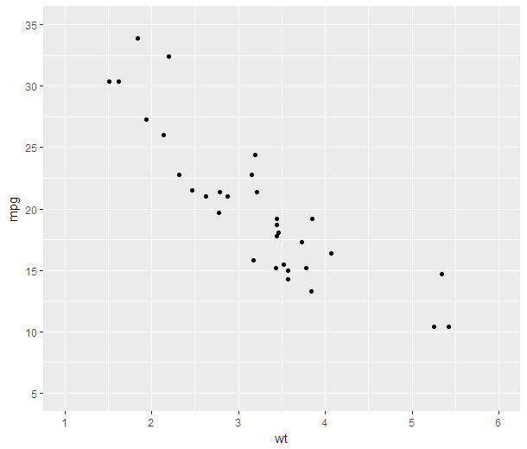
Scales
ggplot(mtcars, aes(x=wt, y=mpg)) + geom_point() +
scale_x_continuous(breaks=seq(1,6,1), limits=c(1, 6)) +
scale_y_continuous(breaks=seq(5, 35, 5),limits=c(5,35))

Slide 35
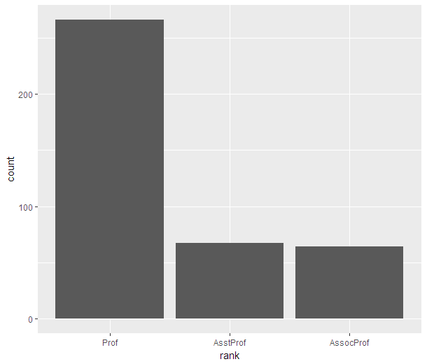
Scales
ggplot(Salaries, aes(x=rank)) + geom_bar() +
scale_x_discrete(limits = c("Prof", "AsstProf", "AssocProf"))
breaks, limits,
labels
use limits
to reorder
levels

Slide 36
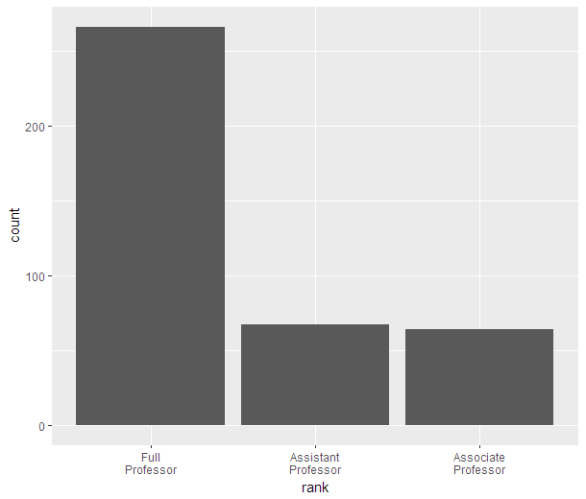
Scales
ggplot(Salaries, aes(x=rank)) + geom_bar() +
scale_x_discrete(limits = c("Prof", "AsstProf", "AssocProf"),
labels = c("Full\nProfessor", "Assistant\nProfessor" , "Associate\nProfessor"))
breaks, limits,
labels
use limits
to reorder
levels

Slide 37
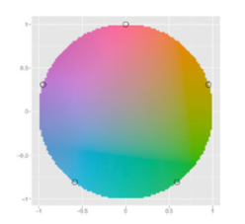
Scales – Color and Fill
picking colors by name - "red"
or hex #ff0000
try colors() to list all built in colors
ggplot2 picks colors from around the circle
for example the 5 points above if there are five levels

Slide 38
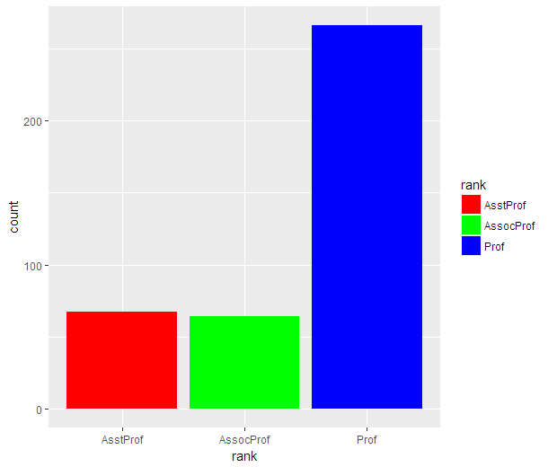
Scales – Color/Fill
ggplot(Salaries, aes(x=rank, fill=rank)) + geom_bar() +
scale_fill_manual(values=c("red", "green", "blue"))

Slide 39
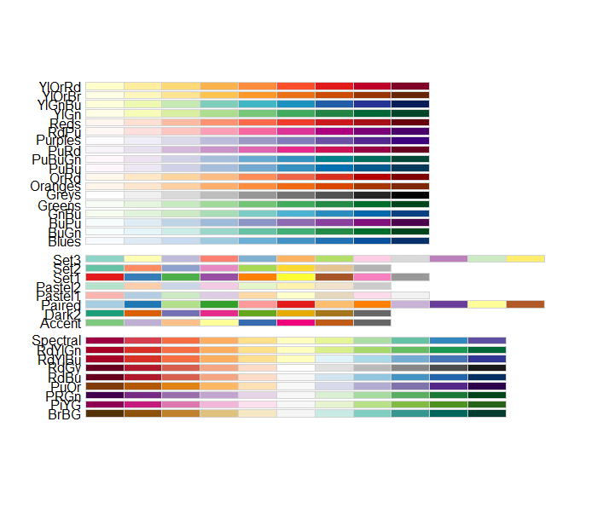
Scales – Color / Fill
Specify a color palate using scale_fill_brewer() scale_color_brewer()
using palette= option

Slide 40
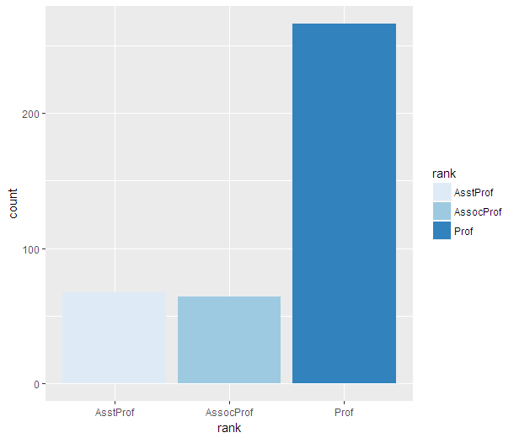
Scales – Color/Fill
ggplot(Salaries, aes(x=rank, fill=rank)) + geom_bar() +
scale_fill_brewer()

Slide 41
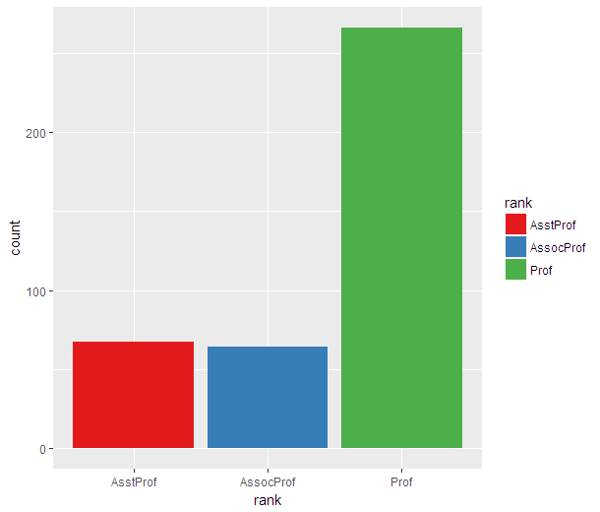
Scales – Color/Fill
ggplot(Salaries, aes(x=rank, fill=rank)) + geom_bar() +
scale_fill_brewer(palette = "Set1")

Slide 42
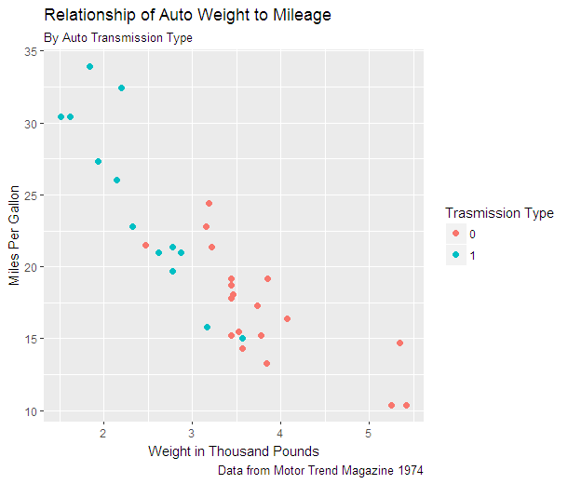
Annotations - Labels
p <- ggplot(data=mtcars, aes(x=wt, y=mpg, color=factor(am))) + geom_point(size=2) +
labs(title="Relationship of Auto Weight to Mileage",
subtitle="By Auto Transmission Type",
caption = "Data from Motor Trend Magazine 1974",
x = "Weight in Thousand Pounds",
y="Miles Per Gallon",
color = "Transmission Type")
p

Slide 43
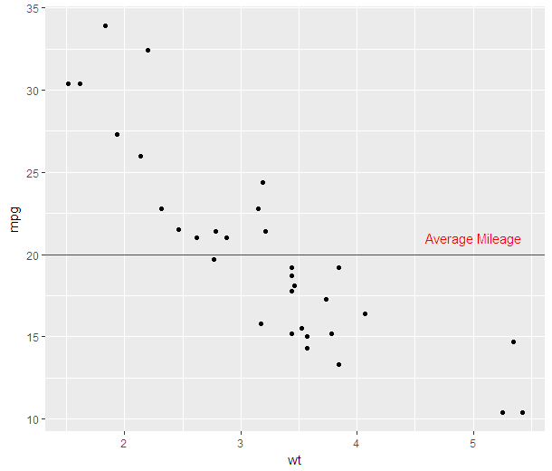
Annotations – reference lines and labels
ggplot(data=mtcars, aes(x=wt, y=mpg)) + geom_point() +
geom_hline(yintercept=20, color="red") +
annotate("text", x=5, y=21, label="Average Mileage", color="red")

Slide 44
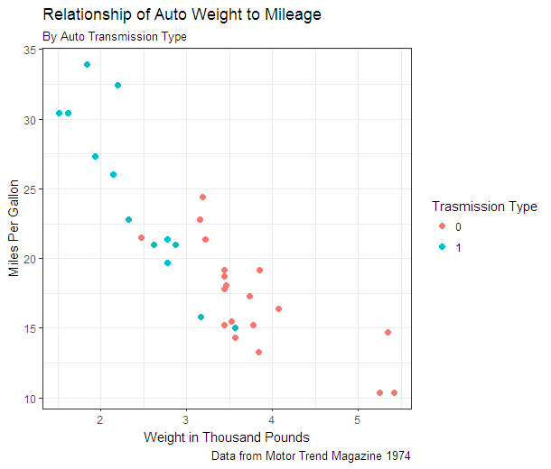
Themes - prepackaged
p + theme_bw()

Slide 45
Themes - prepackaged
library(ggthemes)
theme_base: a theme resembling the default base graphics in R. See also theme_par.
theme_calc: a theme based on LibreOffice Calc.
theme_economist: a theme based on the plots in the The Economist magazine.
theme_excel: a theme replicating the classic ugly gray charts in Excel
theme_few: theme from Stephen Few's "Practical Rules for Using Color in Charts".
theme_fivethirtyeight: a theme based on the plots at fivethirtyeight.com.
theme_gdocs: a theme based on Google Docs.
theme_hc: a theme based on Highcharts JS.
theme_par: a theme that uses the current values of the base graphics parameters in par.
theme_pander: a theme to use with the pander package.
theme_solarized: a theme using the solarized color palette.
theme_stata: themes based on Stata graph schemes.
theme_tufte: a minimal ink theme based on Tufte's The Visual Display of Quantitative Information.
theme_wsj: a theme based on the plots in the The Wall Street Journal.

Slide 46
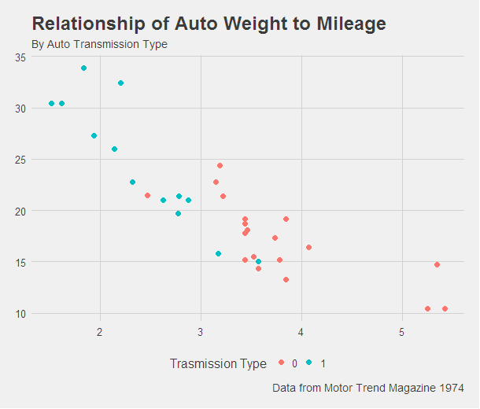
Themes - prepackaged
library(ggthemes)
p + theme_fivethirtyeight()

Slide 47
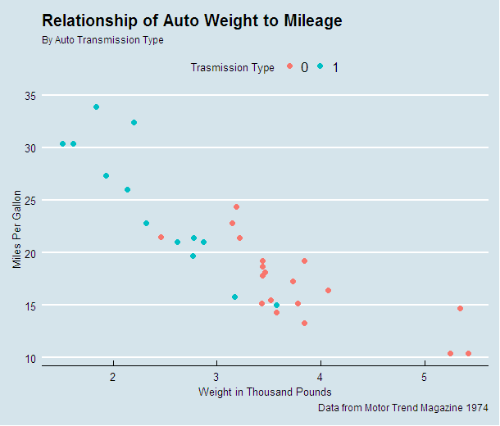
Themes - prepackaged
library(ggthemes)
p + theme_economist()

Slide 48
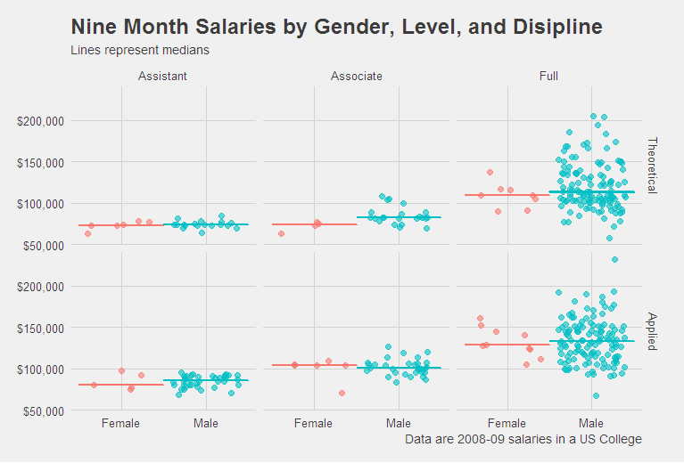
Getting Fancy

Slide 49
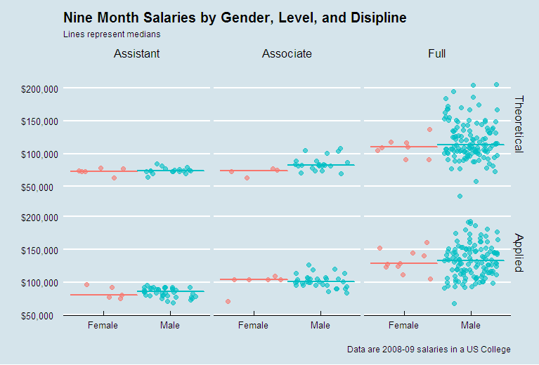
Getting Fancy

Slide 50
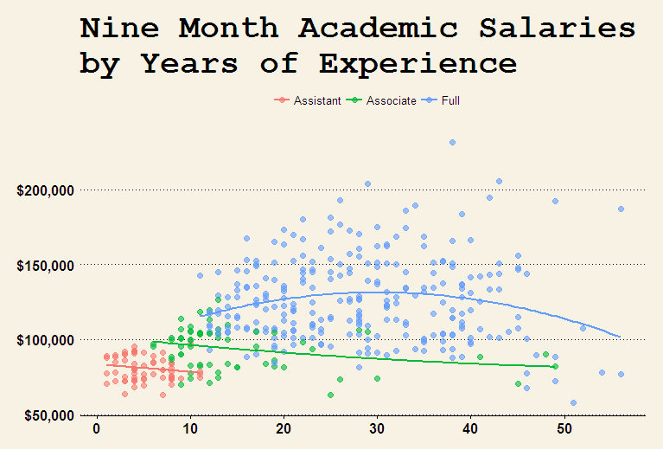
Getting Fancy

Slide 51
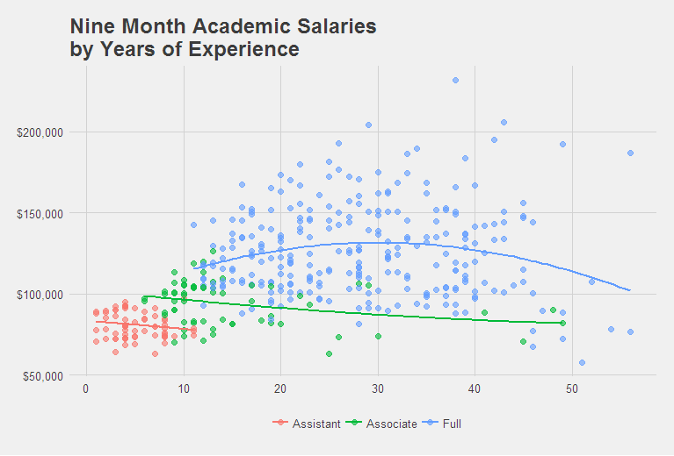
Getting Fancy

Slide 52
Saving your work
ggsave(filename="filename.ext", plot=)
ext can be
eps, ps, tex, pdf, jpeg, tiff, png, bmp, svg, wmf
plot defaults to last one created
wmf on windows platforms only
svg can be edited using Inkscape

Slide 53
Learning more
Hadley Wickham – http://docs.ggplot2.org/
Winston Chang- http://wiki.stdout.org/rcookbook/Graphs/

